Slide 1
30.10.2024

Slide 2
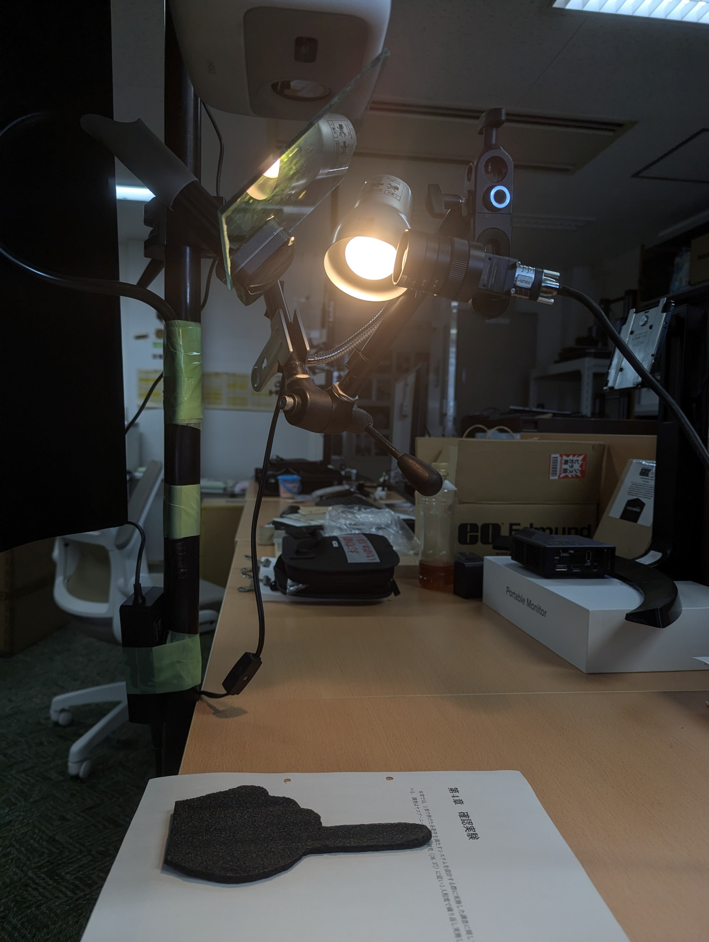

Slide 3
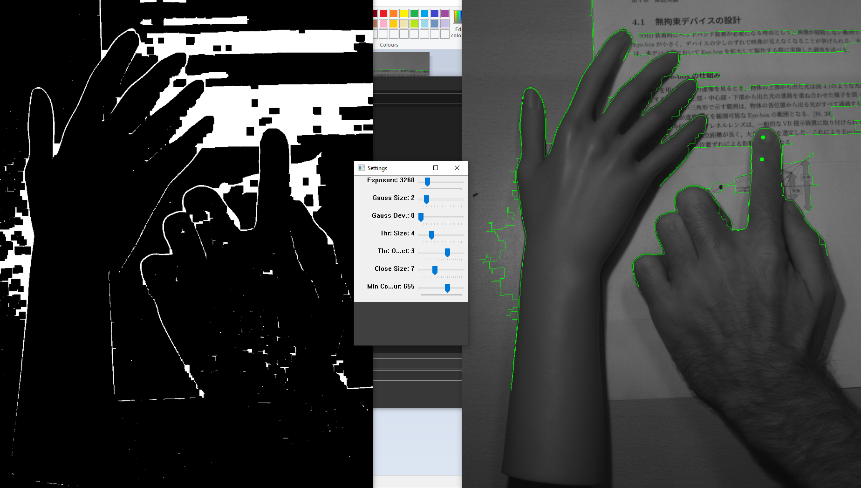

Slide 4
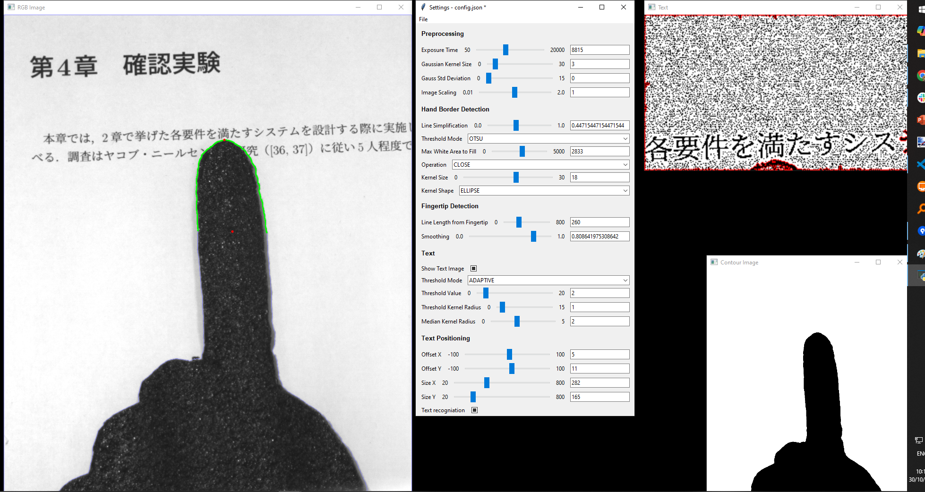

Slide 5
Milestones
Fingertip detection
Text recognition
Text translation
Fingernail detection
Fingernail projection

Slide 6

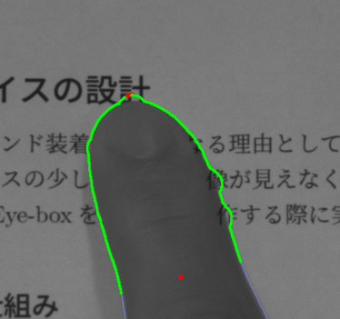
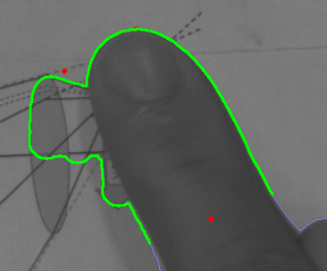
Challenges
Complicated Kanji are hard to recognize with the current camera-setup
Images or different font sizes

Slide 7
13.11.2024

Slide 8
Milestones
Fingertip detection
Text detection
Fix text orientation
Fix text bounding boxes
Crop window of interest automatically
Text translation
Fingernail detection
Fingernail projection

Slide 9
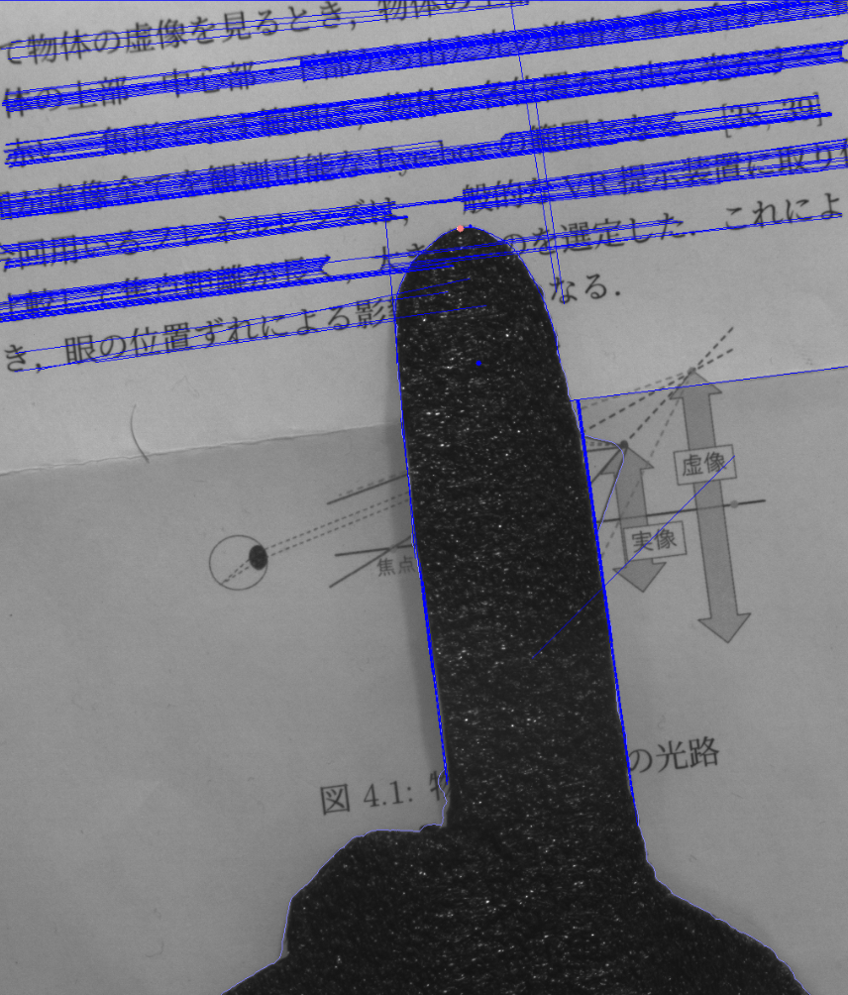
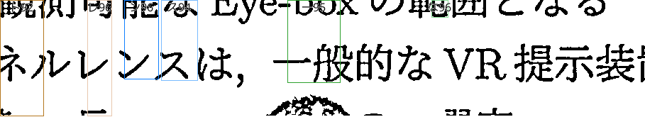
Fix text orientation with Hough Line Transform

Slide 10
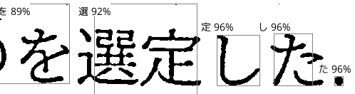
Fix wrong bounding boxes Manual segmentation and alignment

Slide 11
26.11.2024

Slide 12
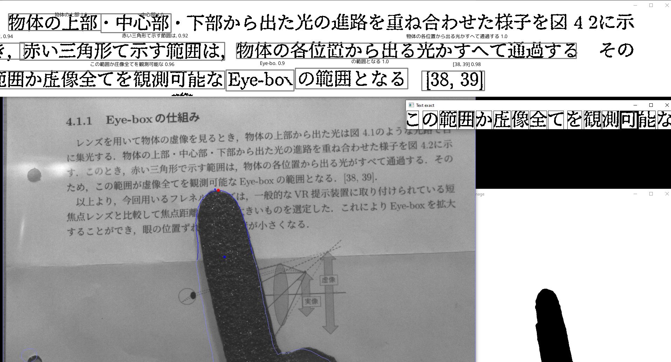
Detecting correct characters

Slide 13
Milestones
Fingertip detection
Text detection
Fix text orientation
Fix text bounding boxes
Crop window of interest automatically
Get word of interest
Text translation
Get meaning of word depending on context (using Bert?)
Fingernail detection
Fingernail projection

Slide 14
Milestones: more robustness needed
Fingertip detection
Text detection
Fix text orientation
Fix text bounding boxes
Crop window of interest automatically
Get word of interest
Text translation
Get meaning of word depending on context (using Bert?)
Fingernail detection
Fingernail projection

Slide 15
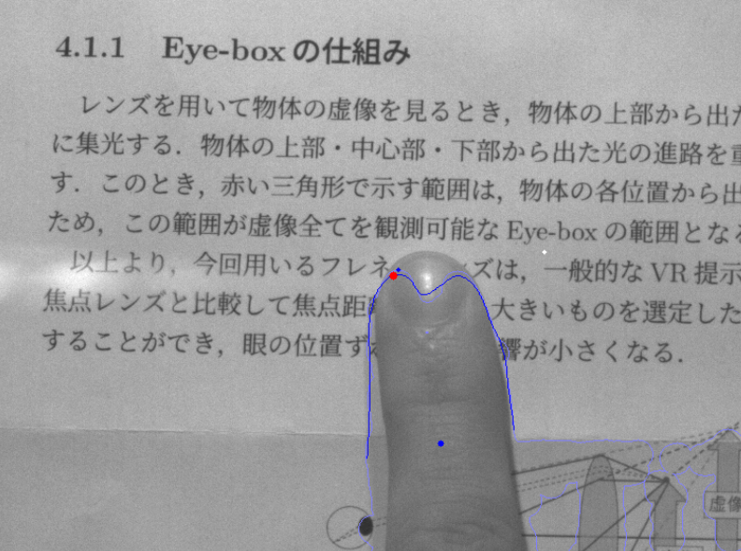
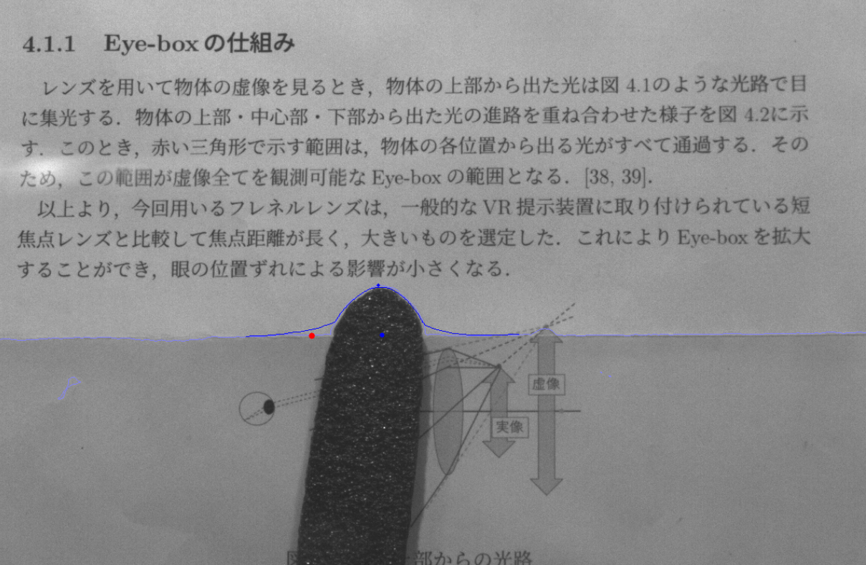
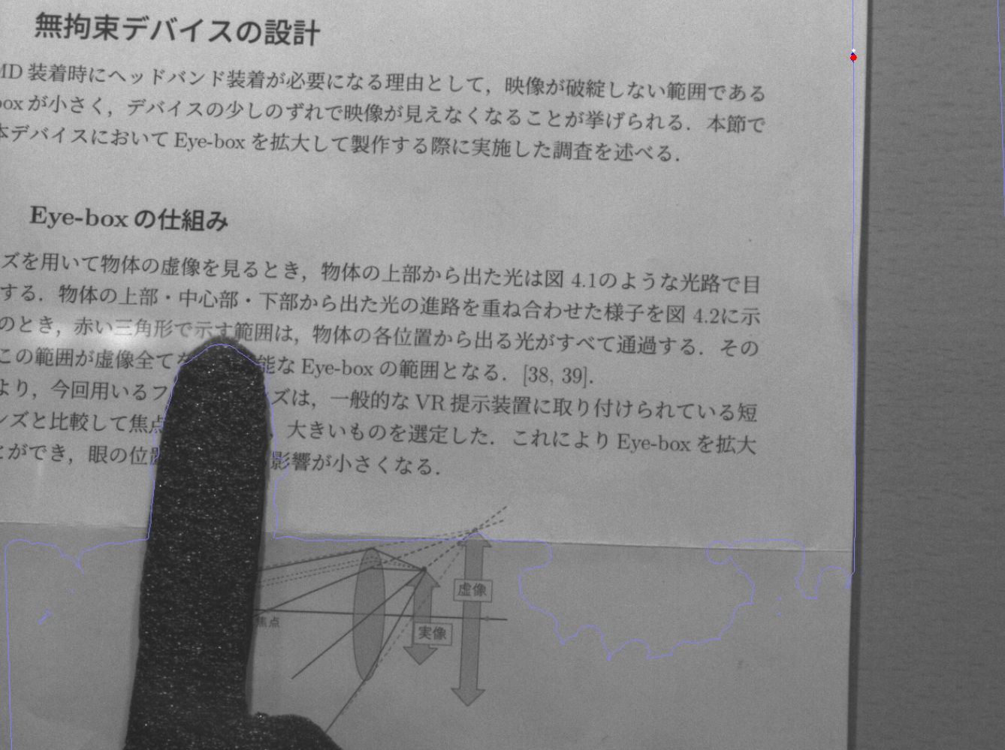
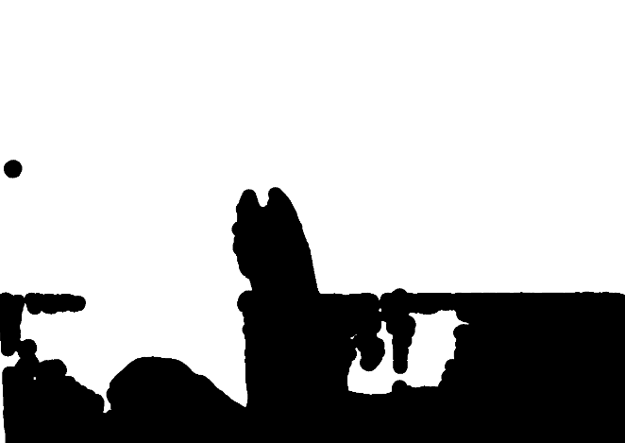


Fingertip detection

Slide 16

Fix text bounding boxes

Slide 17
03.12.2024

Slide 18
Previously: Fix wrong bounding boxes Manual segmentation and alignment

Slide 19
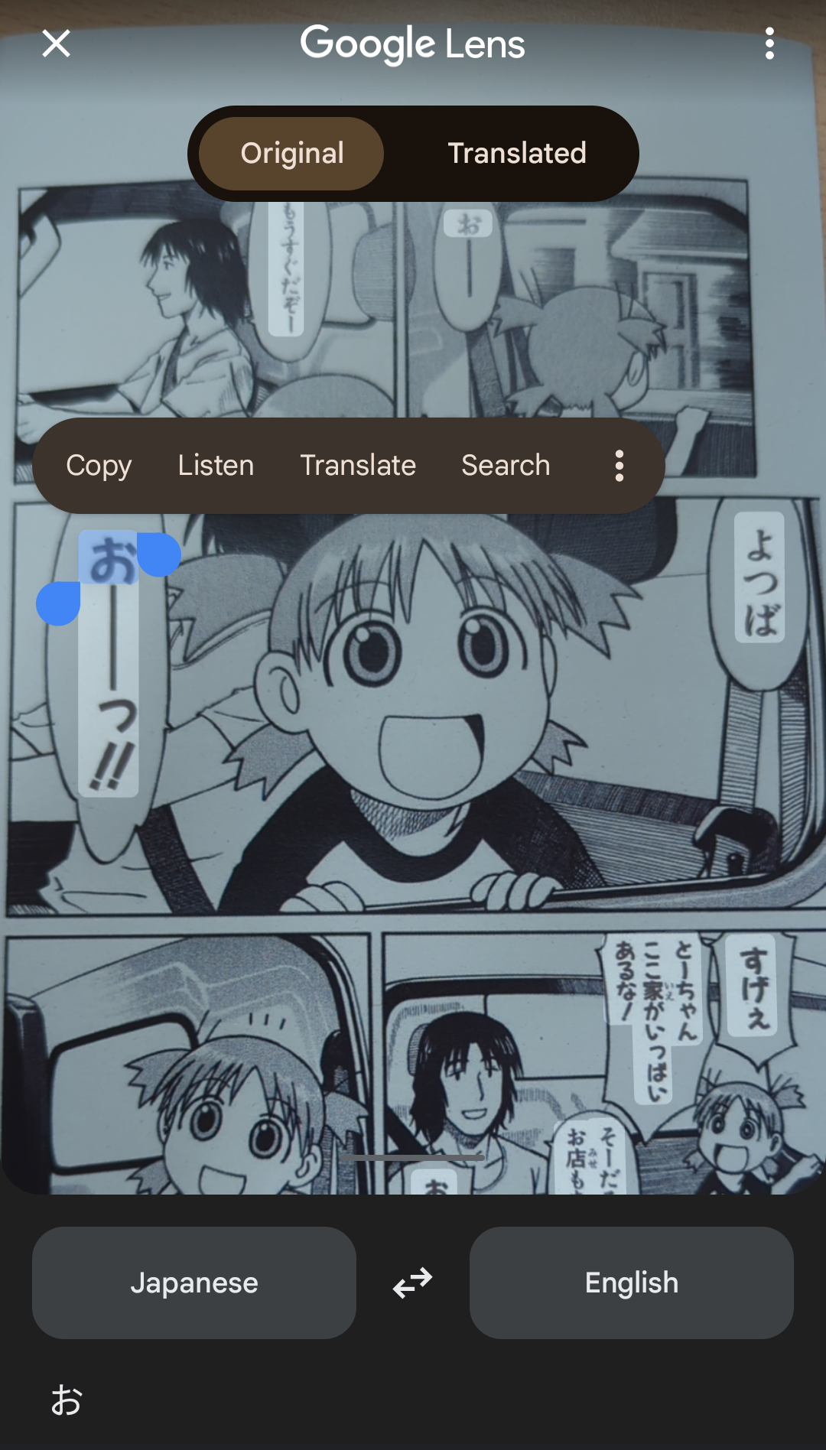


Slide 20
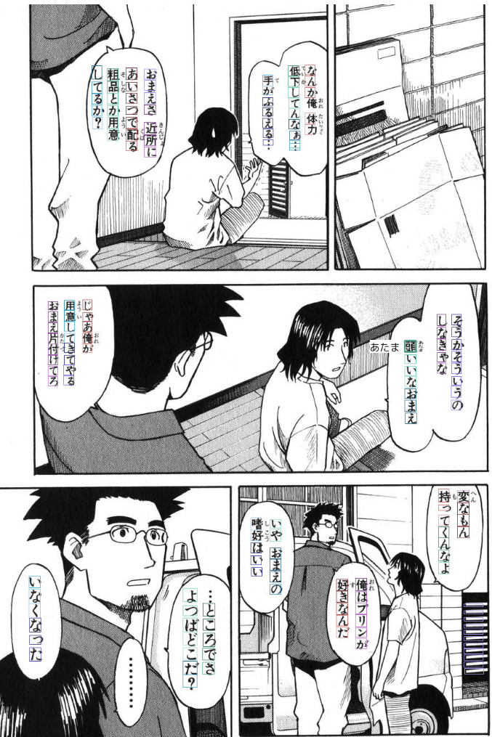

(first 1000 images per month are free)

Slide 21




Store image for later usage

